Slide 1
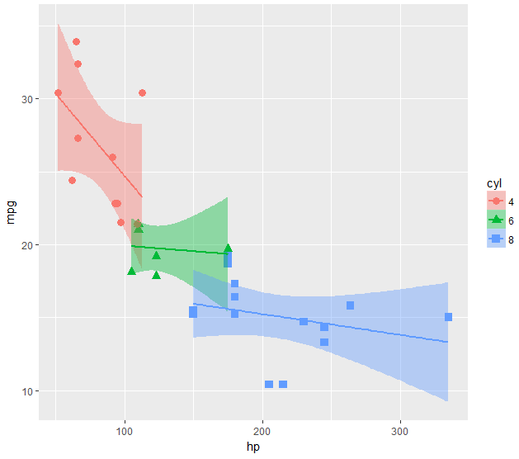
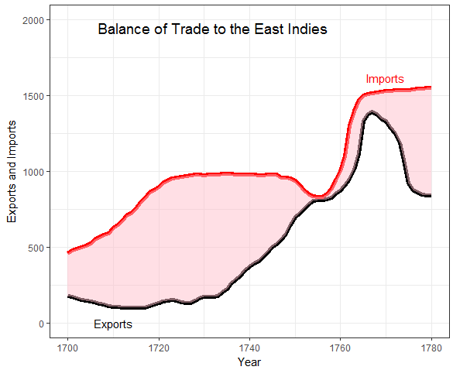
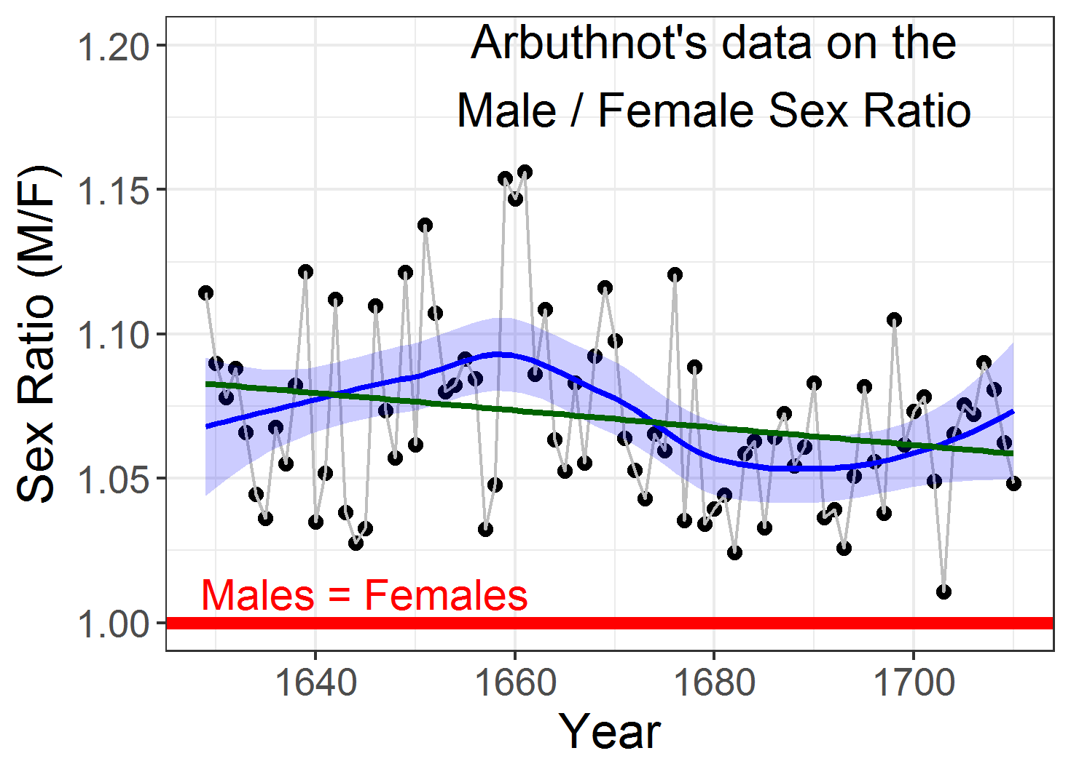
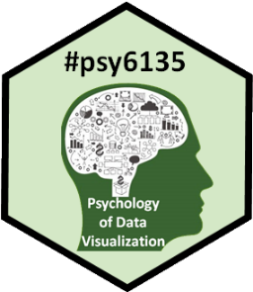
Introduction to ggplot2
Michael Friendly
Psych 6135
https://friendly.github.io/6135

Slide 2
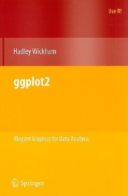
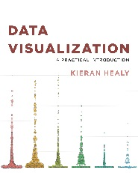
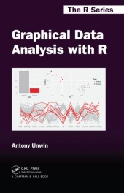
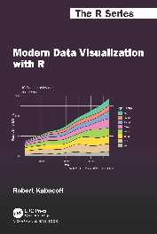
Resources: Books
Hadley Wickham, ggplot2: Elegant graphics for data analysis, 2nd Ed.
1st Ed: Online, http://ggplot2.org/book/
ggplot2 Quick Reference: http://r-statistics.co/ggplot2-cheatsheet.html
Complete ggplot2 documentation: http://docs.ggplot2.org/current/
Kieran Healy, Data Visualization, a Practical Introduction
A hands-on introduction to data visualization using ggplot2, with a wide range of topics.
The online version: https://socviz.co/ is a great example of R bookdown publishing.
Antony Unwin, Graphical Data Analysis with R
A gentile introduction to doing visual data analysis, mainly with ggplot2.
R code: http://www.gradaanwr.net/
Robert Kabakoff, Modern Data Visualization with R
A comprehensive guide to creating data visualizations using R, mainly ggplot2, but also base R, and other tools
Online book: https://rkabacoff.github.io/datavis/
R code & data: https://github.com/rkabacoff/datavis_support

Slide 3
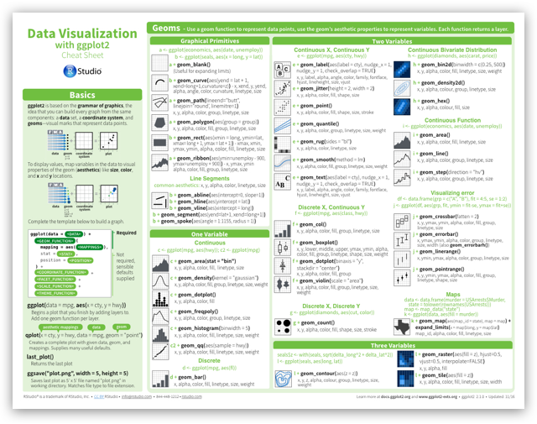
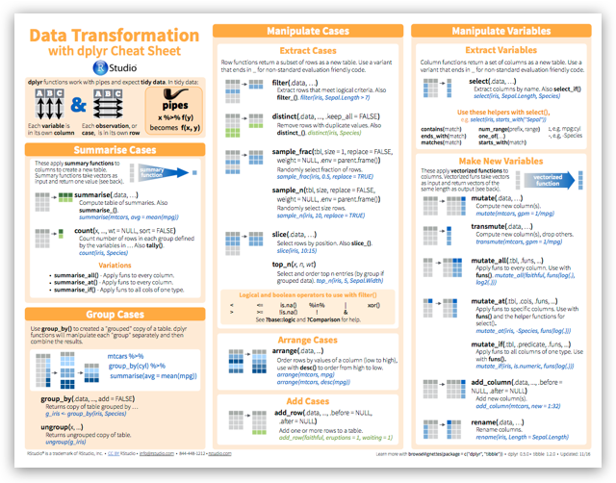
Resources: Cheat sheets
R Studio maintains a large number of cheat sheets, https://www.rstudio.com/resources/cheatsheets/
Topics:
R Studio IDE, Data import, Data transformation (dplyr), Data visualization (ggplot2), R Markdown, …
My collection: R Studio Cheat Sheets

Slide 4
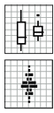
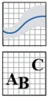
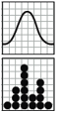
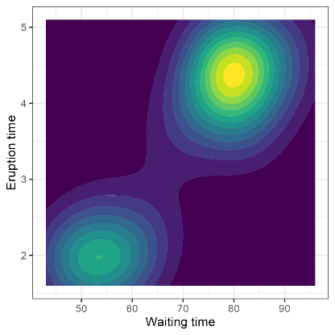
Topics for today
ggplot overview
components: geoms, stats, scales, …
getting stylish: themes
Using NICE fonts
Revisioning old masters
Playfair, balance of trade
Arbuthnot’s birth ratios
Guerry’s enhanced scatterplots
Beyond 2D
Animation

Slide 5
What is ggplot2?
ggplot2 is Hadley Wickham’s R package for producing “elegant graphics for data analysis”
An implementation of the ideas for graphics introduced in Lee Wilkinson’s Grammar of Graphics
Ideas and the syntax of ggplot2 help to think of graphs in a new and more general way
→pleasing plots, taking care of many fiddly details (legends, axes, colors, …)
Built on the “grid” graphics system: consistency
Open software, with a large number of gg_ extensions. See: https://exts.ggplot2.tidyverse.org/gallery/

Slide 6
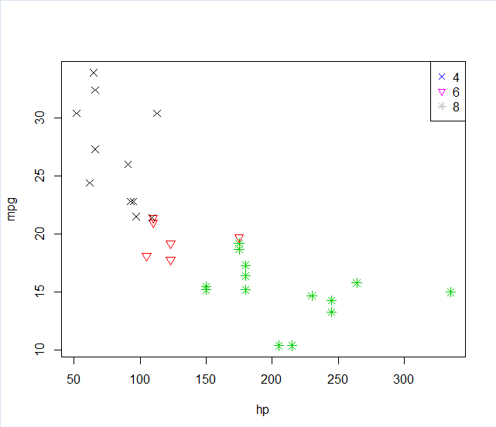
ggplot vs base graphics
Some things that should be simple are harder than you’d like in base graphics
Here, I’m plotting gas mileage (mpg) vs. horsepower and want to use color and shape for different # of cylinders.
But I don’t quite get it right!
mtcars$cyl <- as.factor(mtcars$cyl)
plot(mpg ~ hp , data=mtcars,
col=cyl, pch=c(4,6,8)[mtcars$cyl], cex=1.2)
legend("topright", legend=levels(mtcars$cyl),
pch = c(4,6,8),
col=levels(mtcars$cyl))
colors and point symbols work differently in plot() and legend()
goal of ggplot2: this should “just work”

Slide 7

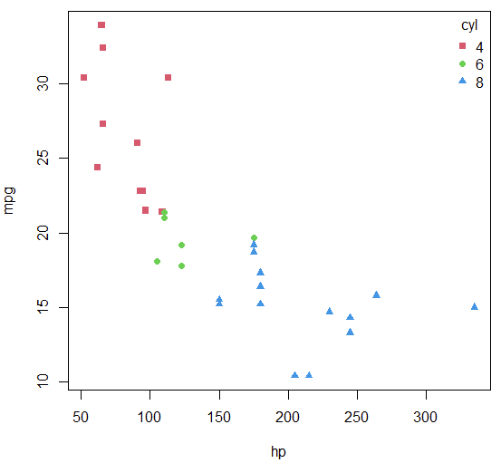
Now there’s tinyplot()
tinyplot: A lightweight, drop-in replacement for base R plot() with many conveniences.
Formula interface: y ~ x | group
Legend handled automatically
Allows facets & themes
Standard plot types: “p” (points), “l” (lines), “b” (both),
New plot types:
“lm” (regression lines)
“loess” (smooth)
“jitter”, “boxplot”, “density”
library(tinyplot)
tinyplot(mpg ~ hp | cyl, data = mtcars,
legend = "topright",
col = palette()[2:4],
pch = 15:17)
R script: https://friendly.github.io/6135/R/tinyplot.R
Tutorial: https://grantmcdermott.com/tinyplot/vignettes/intro_tutorial.html

Slide 8
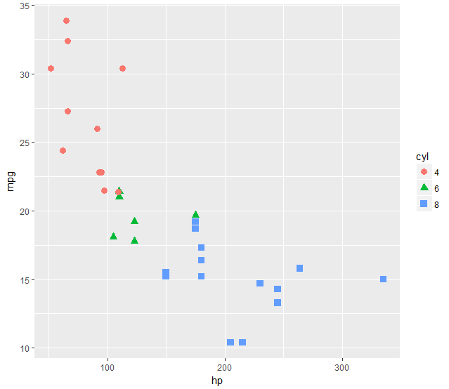

ggplot vs base R graphics
In ggplot2, just map the data variables to aesthetic attributes
aes(x, y, shape, color, size, …)
ggplot() takes care of the rest
aes() mappings set in the call to ggplot() are passed to geom_point() here
library(ggplot2)
ggplot(mtcars, aes(x=hp, y=mpg, color=cyl, shape=cyl)) +
geom_point(size=3)
Color & shape vars must be factors
Follow along: R script for this example is at: https://friendly.github.io/6135/R/gg-cars.R

Slide 9
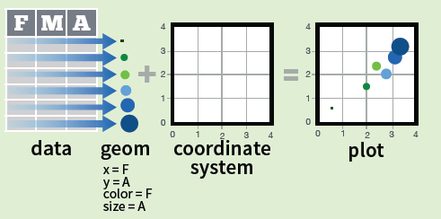
ggplot components
Every graph can be described as a combination of independent building blocks:
data: a data frame: quantitative, categorical; local or data base query
aesthetic mapping of variables into visual properties: size, color, x, y
geometric objects (“geom”): points, lines, areas, arrows, …
coordinate system (“coord”): Cartesian, log, polar, map,

Slide 10
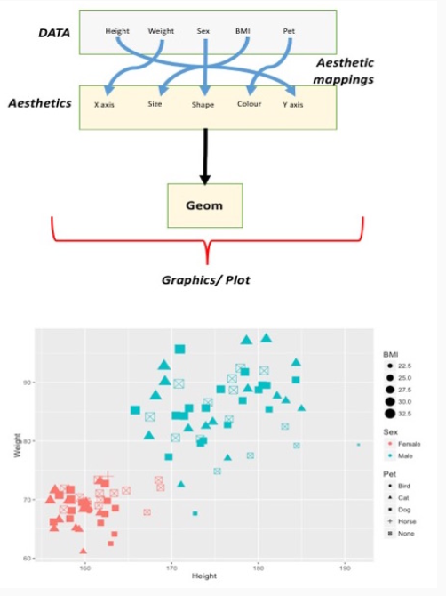
Aesthetic mapping
aes() maps data variables into visual properties
Axes: x, y
size, color, shape, fill
Lines: linetype, linewidth
ggplot(data = patients,
aes(y = Weight, x = Height,
color = Sex, size = BMI,
shape = Pet)) +
geom_point()
From: https://rockefelleruniversity.github.io/Plotting_In_R/presentations/slides/ggplot2.html

Slide 11
ggplot: data + geom -> graph
ggplot(data=mtcars,
aes(x=hp, y=mpg,
color=cyl, shape=cyl)) +
geom_point(size=3)
❶
❷
❸
❹
In this call,
data=mtcars: data frame
aes(x=hp, y=mpg): plot variables
aes(color, shape): attributes
geom_point(): what to plot
the coordinate system is taken to be the standard Cartesian (x,y)

Slide 12
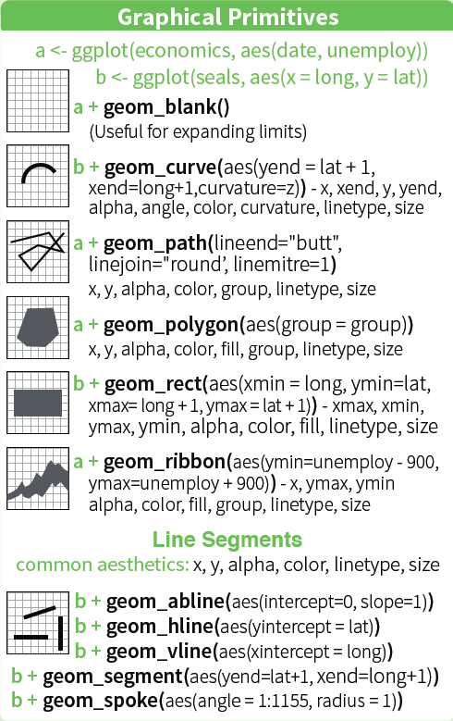
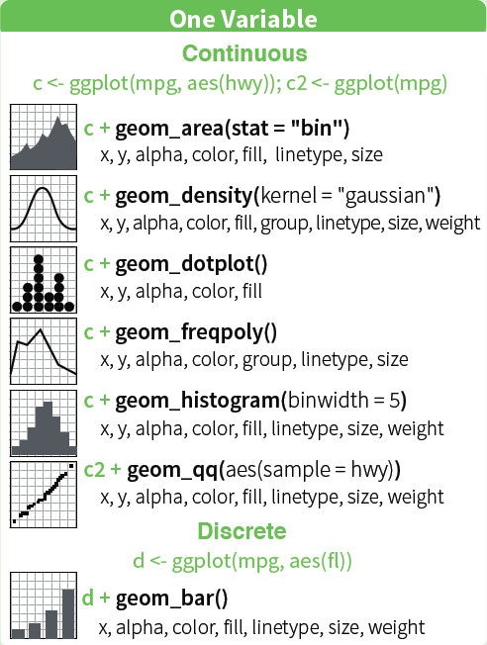
ggplot geoms: basic

Slide 13
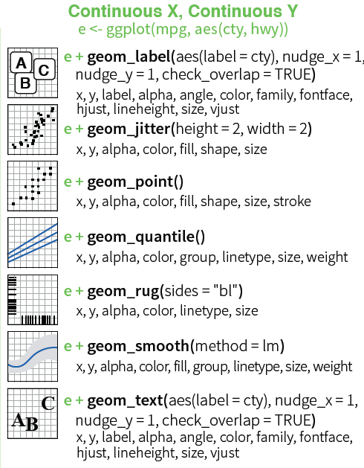
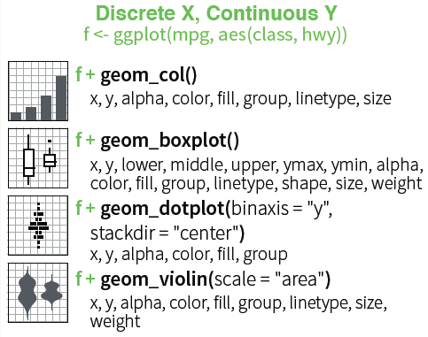
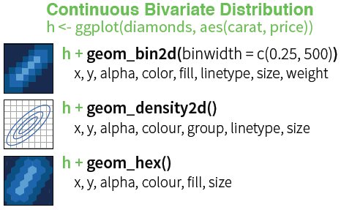
ggplot geoms: two variables

Slide 14
ggplot: geoms
Basic plot
How can I enhance this visualization?
Easy: add a geom_smooth() to fit linear regressions for each level of cyl
It is clear that horsepower and # of cylinders are highly related (Duh!)
ggplot(mtcars, aes(x=hp, y=mpg, color=cyl, shape=cyl)) +
geom_point(size=3) +
geom_smooth(method="lm", aes(fill=cyl))

Slide 15
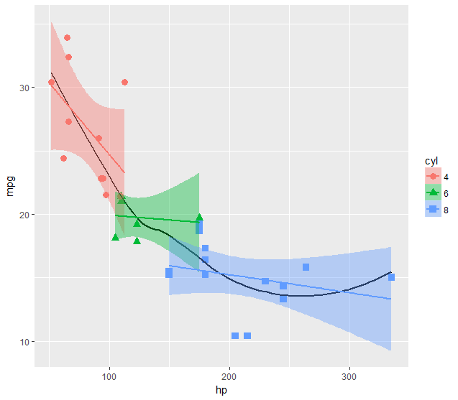
ggplot: Inheritance in layers & aes()
Aesthetic attributes in the ggplot() call are inherited in geom_() layers
Attributes can also be passed as constants (size=3, color=“black”) or
with aes(color=, …) in different layers
This plot adds an overall loess smooth to the previous plot.
color=“black” overrides the aes(color=cyl)
ggplot(mtcars, aes(x=hp, y=mpg)) +
geom_point(size=3, aes(color=cyl, shape=cyl)) +
geom_smooth(method="lm", aes(color=cyl, fill=cyl)) +
geom_smooth(method="loess", color="black", se=FALSE)

Slide 16
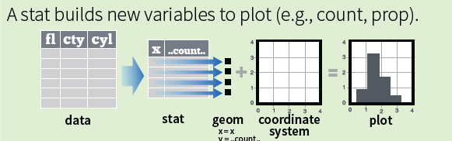
ggplot: stats
statistical calculations (“stat”) -- data summaries: mean, sd, binning & counting, …
stats have a default geom and geoms have a default stat
geom_bar(stat = “count”) ← → stat_count(geom = “bar”)
computed variables (eg, ..count.., ..level..) can be mapped to aesthetics
ggplot(aes(x=, y=)) + stat_density_2d(aes(fill = ..level..), geom=“polygon”)
some stats:
stat_count()
stat_bin()
stat_density()
stat_boxplot()
stat_density_2d()
stat_ellipse()

Slide 17

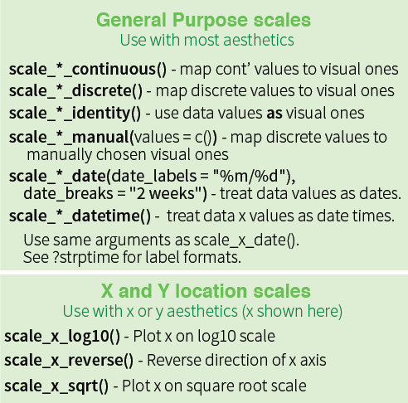
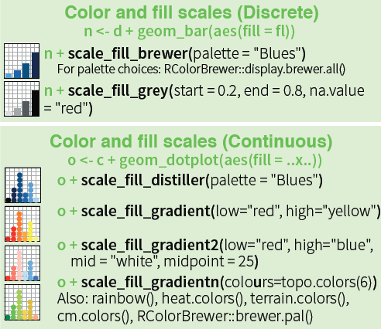
scales
Scales map data values to the visual values of an aesthetic.
axis labels, legends, colors
formatting of values (currencies: $100, €2.50; percents: 2.5%, 50%, …)
NB: diff scales for discrete vs continuous

Slide 18
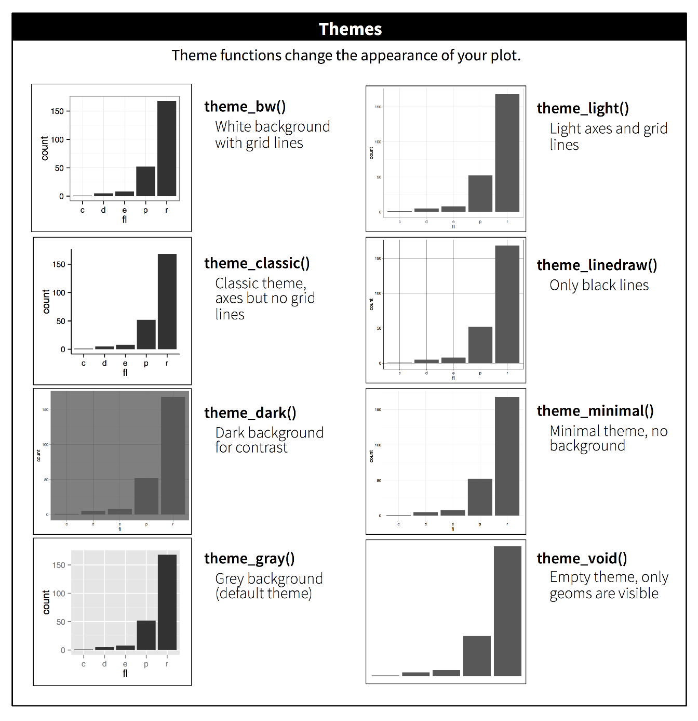
ggplot themes
ggplot themes set the general style for all graphic elements
Designed to provide a pleasing coherent design – simply!
Yet, all the details can be customized
One theme can rule them all!

Slide 19
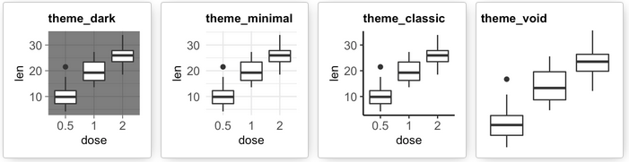
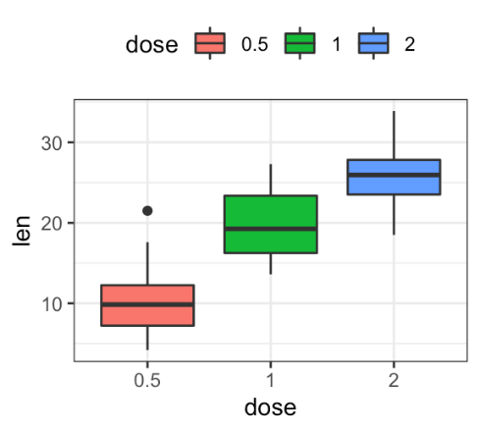
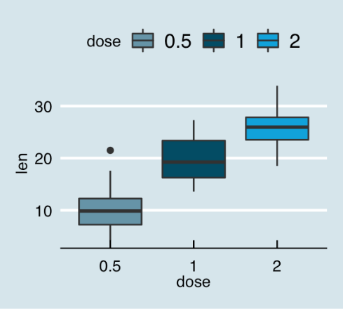
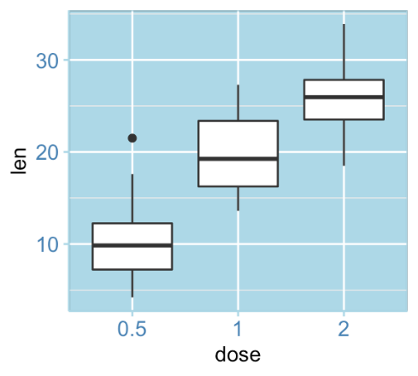
ggplot2: themes
Built-in ggplot themes provide a wide variety of basic graph styles
Other packages provide custom themes, or you can easily define your own
theme_hc()
theme_economist()
theme_bluewhite()

Slide 20
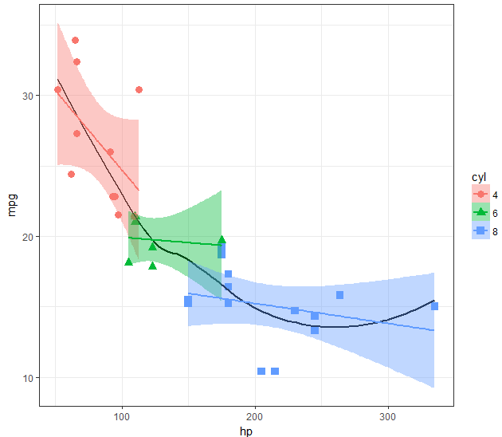

ggplot2: themes
All the graphical attributes of ggplot2 are governed by themes – settings for all aspects of a plot
A given plot can be rendered quite differently just by changing the theme
If you haven’t saved the ggplot object, last_plot() gives you something to work with further
last_plot() + theme_bw()
Tip: set base_size = here to control all text size

Slide 21
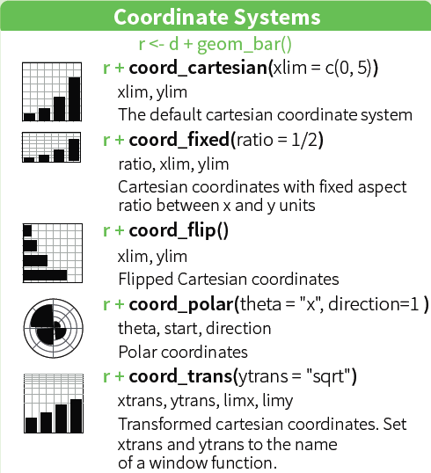
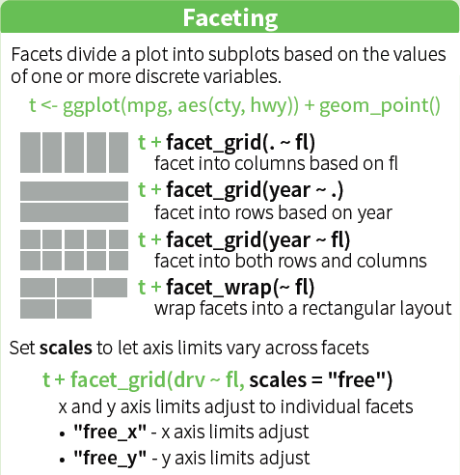
Other ggplot features
Zoom / clip : use xlim, ylim = c(lo,hi)

Slide 22
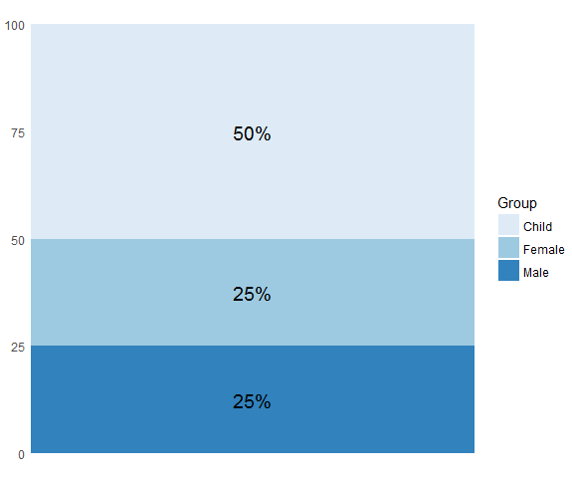
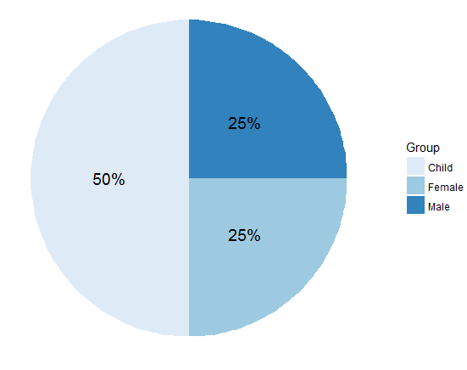
ggplot2: coords
Coordinate systems, coord_*() functions, handle conversion from geometric objects to what you see on a 2D plot.
A simple bar chart, standard coordinates
A pie chart is just a bar chart in polar coordinates!
p <- ggplot(df, aes(x = "", y = value, fill = group)) +
geom_bar( stat = "identity")
p + coord_polar("y", start = 0)

Slide 23
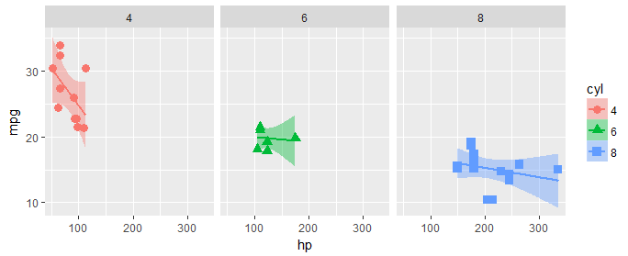
ggplot2: facets
Facets divide a plot into separate subplots based on one or more discrete variables
plt <-
ggplot(mtcars, aes(x=hp, y=mpg, color=cyl, shape=cyl)) +
geom_point(size=3) +
geom_smooth(method="lm", aes(fill=cyl))
plt + facet_wrap(~cyl)
Also:
facet_wrap(~ cyl + gear)
facet_grid(cyl ~ gear)
by default, same Y scale for each panel

Slide 24
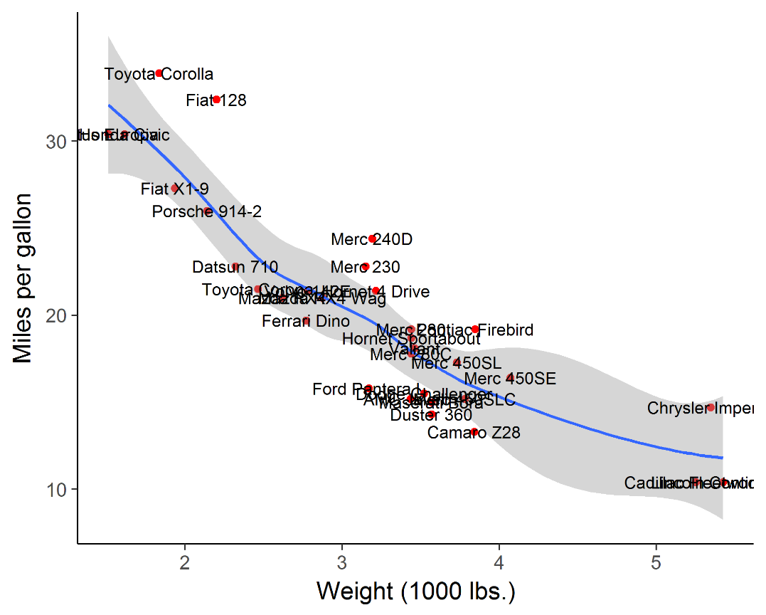
labeling points: geom_text()
plt2 <- ggplot(mtcars, aes(x=wt, y=mpg)) +
geom_point(color = 'red', size=2) +
geom_smooth(method="loess") +
labs(y="Miles per gallon", x="Weight (1000 lbs.)") +
theme_classic(base_size = 16)
plt2 + geom_text(aes(label = rownames(mtcars)))
Sometimes it is useful to label points to show their identities.
geom_text() often gives messy, overlapping text
Note use of theme_classic(), better axis labels & increased font size.
But this is too messy: wouldn’t want to publish this.

Slide 25
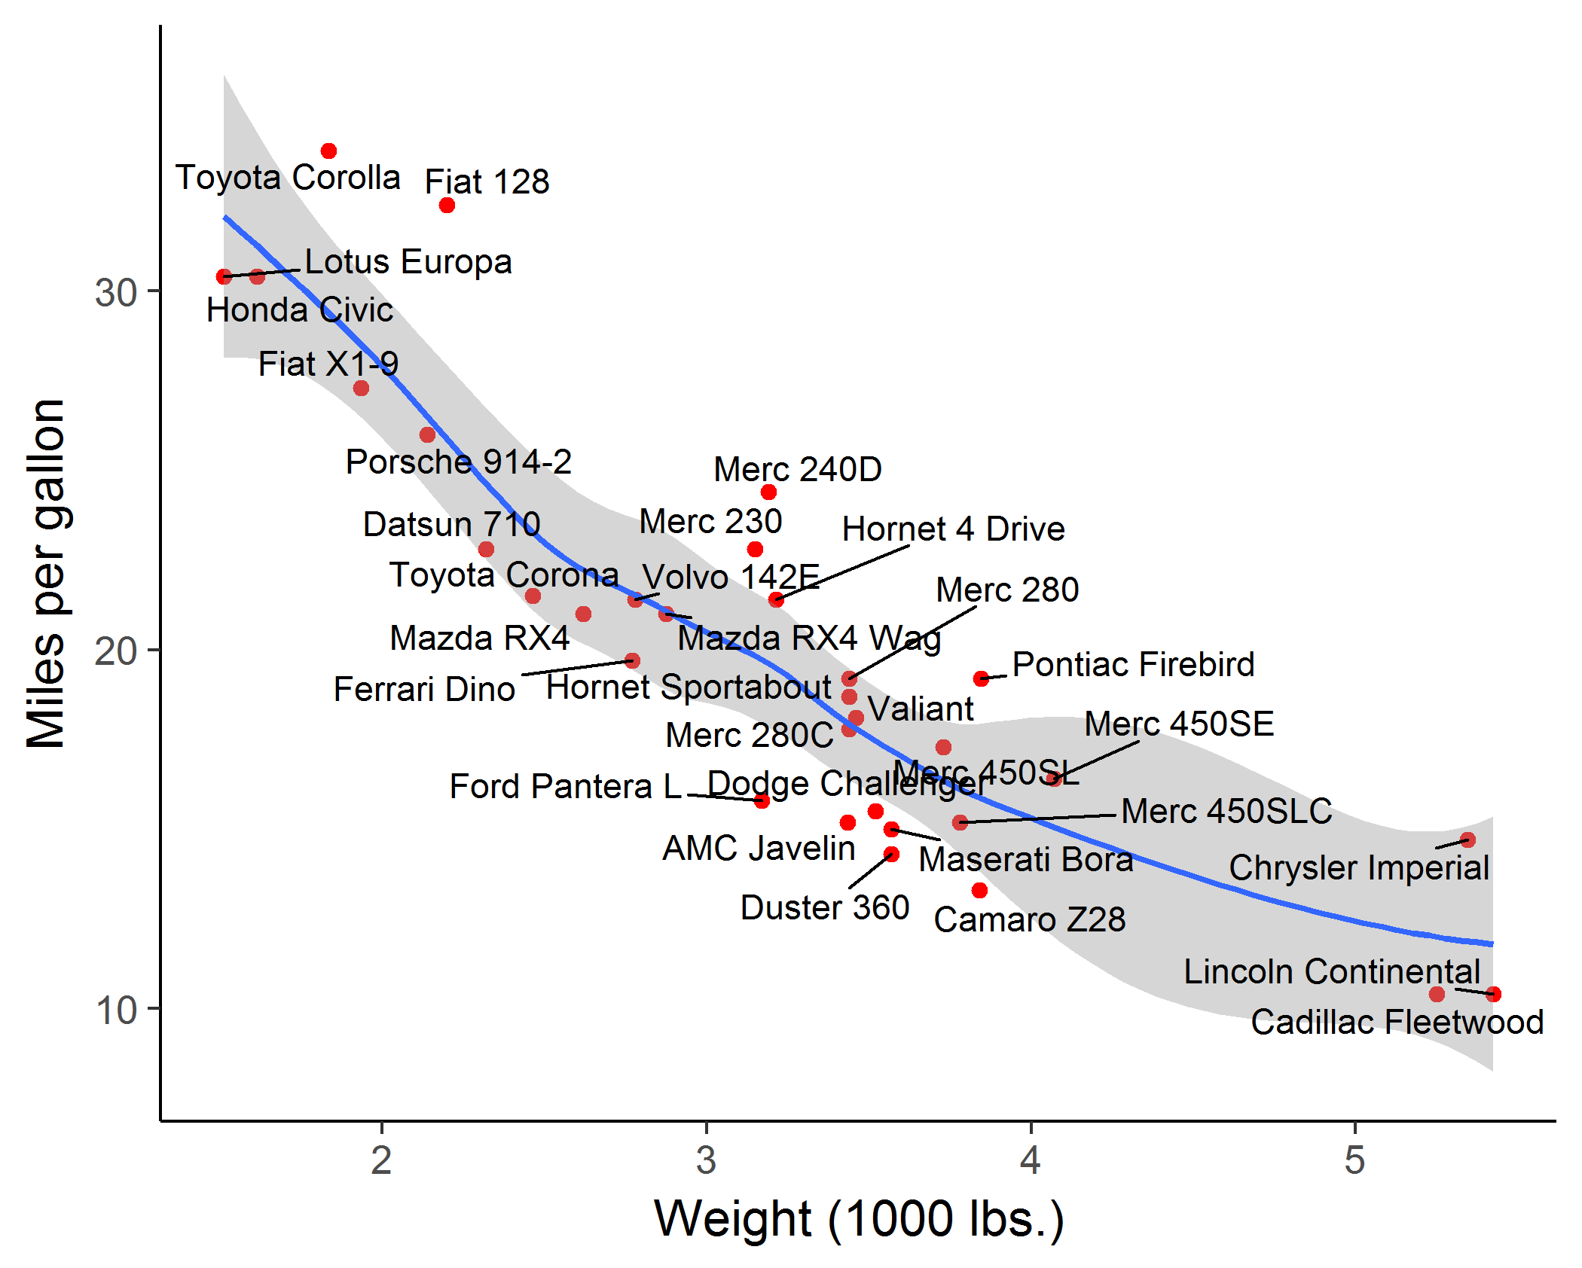
labeling points: geom_text_repel()
library(ggrepel)
plt2 +
geom_text_repel(aes(label = rownames(mtcars)))
geom_text_repel() assigns repulsive forces among points and labels to assure no overlap
Some lines are drawn to make the assignment clearer

Slide 26
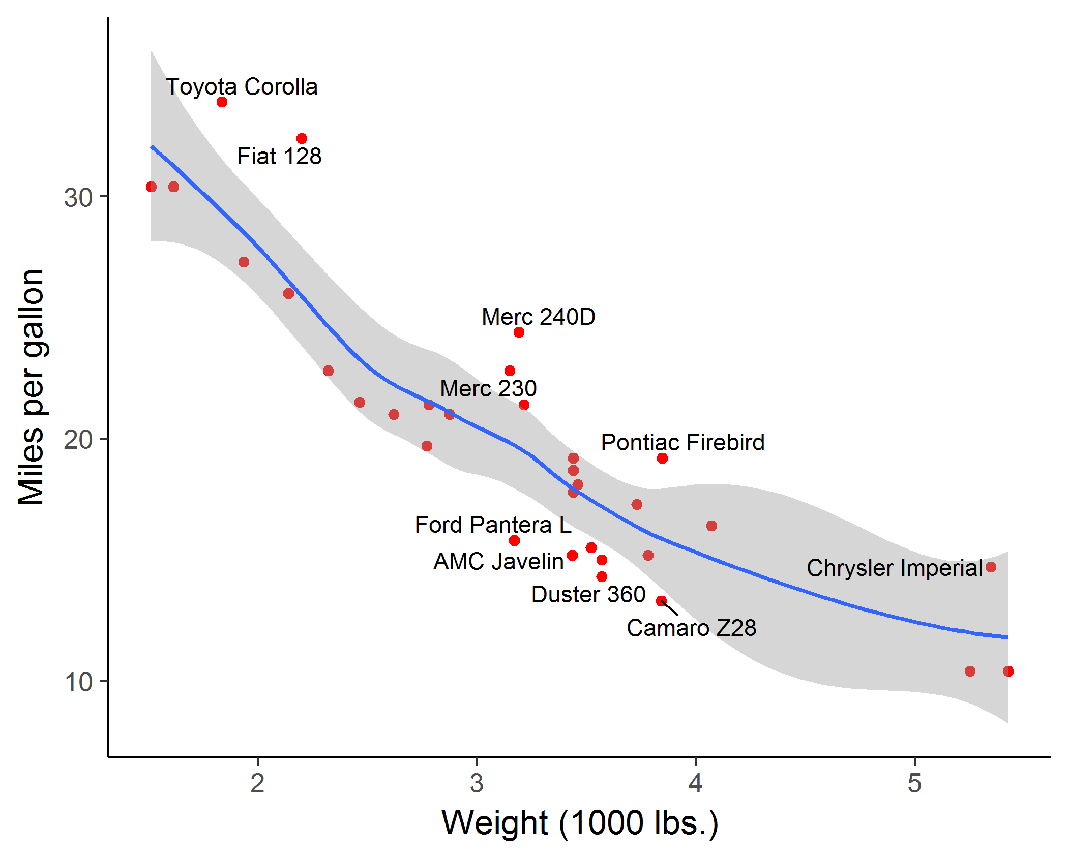
labeling points: selection
It is easy to label points selectively, using some criterion to assign labels to points
mod <- loess( mpg ~ wt, data=mtcars)
resids <- residuals(mod)
mtcars$label <- ifelse(abs(resids) > 2.5,
rownames(mtcars), "")
plt2 + geom_text_repel(aes(label = mtcars$label))
❶
❷
❸
❹
Here, I:
fit the smoothed loess curve,
extract residuals, r_{i}
assign labels where |r_{i}| > 2.5
add the text layer

Slide 27
ggplot objects
Traditional R graphics just produce graphical output on a device
However, ggplot() produces a “ggplot” object, a list of elements
> names(plt)
[1] "data" "layers" "scales" "guides" "mapping" "theme" "coordinates"
[8] "facet" "plot_env" "layout" "labels"
> class(plt)
[1] "gg" "ggplot"
What methods are available?
> methods(class="gg")
[1] +
> methods(class="ggplot")
[1] grid.draw plot print summary
The “gg” class provides the “+” method
The “ggplot” class provides other, standard methods

Slide 28

ggplot objects
summary() is a handy way to see what is inside a ggplot object
> summary(plt)
data: mpg, cyl, disp, hp, drat, wt, qsec, vs, am, gear, carb [32x11]
mapping: x = ~hp, y = ~mpg, colour = ~cyl, shape = ~cyl
faceting: <ggproto object: Class FacetNull, Facet, gg>
compute_layout: function
draw_back: function
…
super: <ggproto object: Class FacetNull, Facet, gg>
-----------------------------------
geom_point: na.rm = FALSE
stat_identity: na.rm = FALSE
position_identity
mapping: fill = ~cyl
geom_smooth: na.rm = FALSE, orientation = NA, se = TRUE
stat_smooth: na.rm = FALSE, orientation = NA, se = TRUE, method = lm
position_identity

Slide 29
Saving plots: ggsave()
If the plot is on the screen:
ggsave(“path/filename.png”) # height=, width=, dpi=
If you have a plot object:
ggsave(myplot, file=“path/filename.png”)
Specify size:
ggsave(myplot, “path/filename.png”, width=6, height=4)
any plot format (pdf, png, eps, svg, jpg, …)
ggsave(myplot, file=“path/filename.jpg”)
ggsave(myplot, file=“path/filename.pdf”)

Slide 30
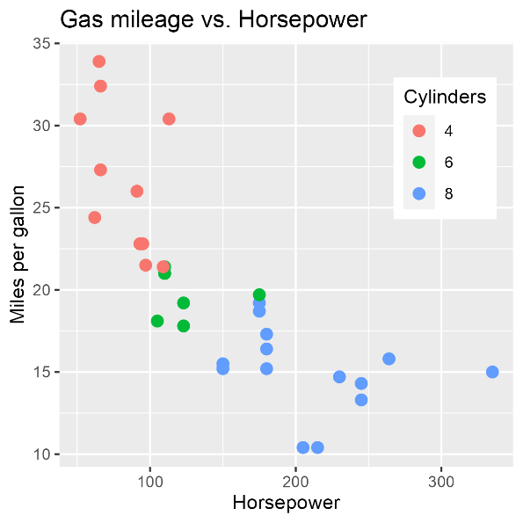
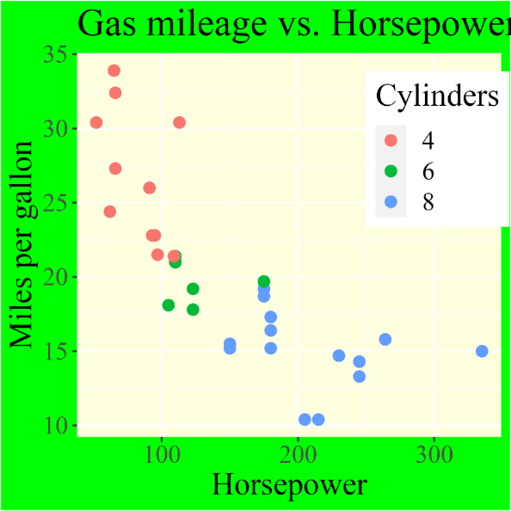
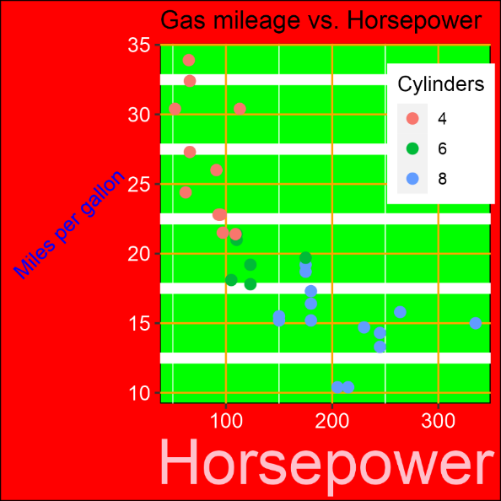
Styling with themes

Slide 31
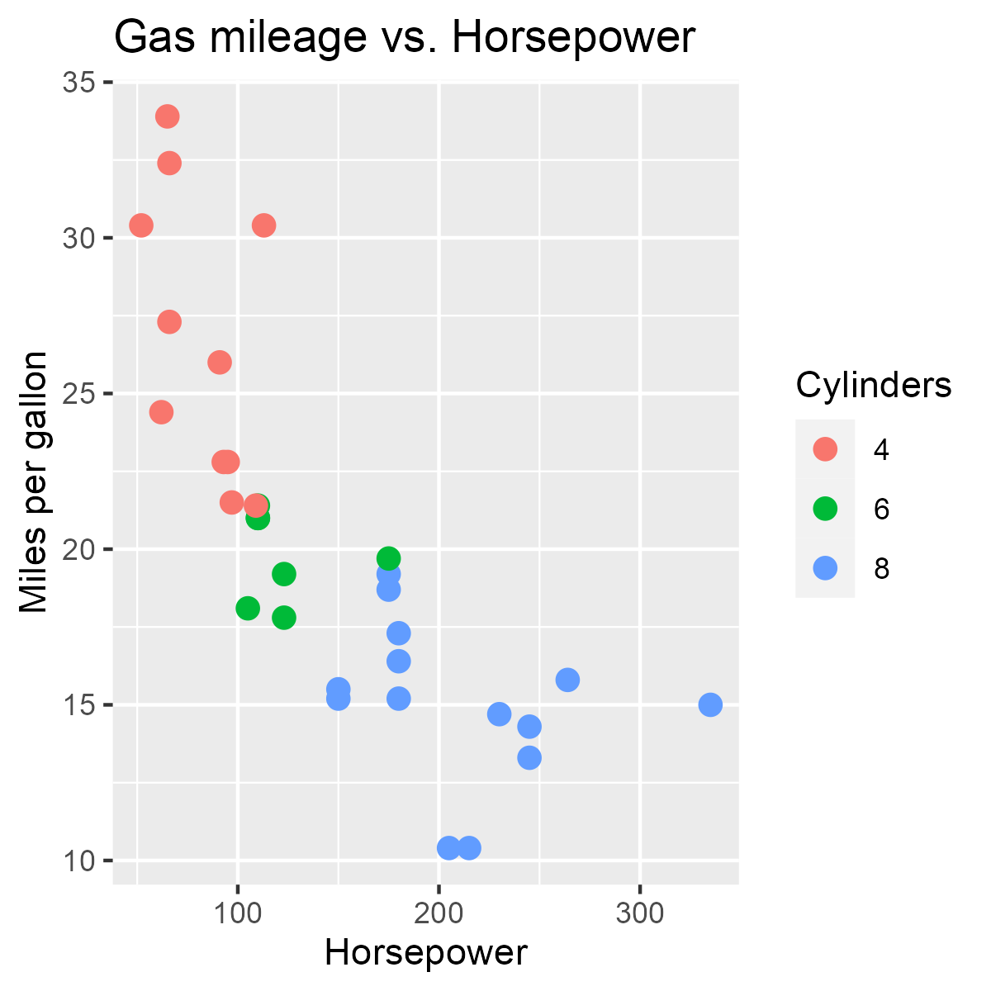
Options vs. themes
p1 <-
ggplot(mtcars, aes(x = hp, y=mpg)) +
geom_point(aes(color=factor(cyl)),
size=3, pch=16 ) +
labs(color = "Cylinders",
x = "Horsepower",
y = "Miles per gallon") +
ggtitle("Gas mileage vs. Horsepower")
p1
Some graphic attributes (size, symbol) are controlled as options of geoms
Others must be controlled by theme elements
ggplot default: theme_gray()

Slide 32

Moving the legend
Move the legend inside the plot region
p1 + theme(
legend.position = “inside”,
legend.position.inside = c(0.85, 0.75))
This gives more room for the data
Legend position is a theme attribute
Might also want to control:
legend title: font, size, label…
legend background, margin, …
Need to know their names & properties

Slide 33
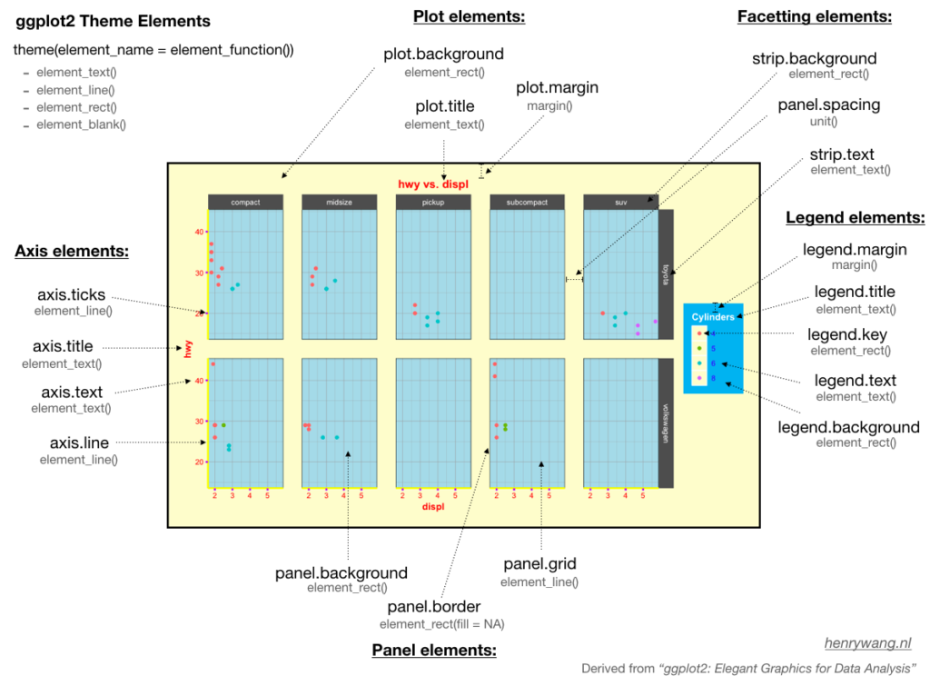

Slide 34
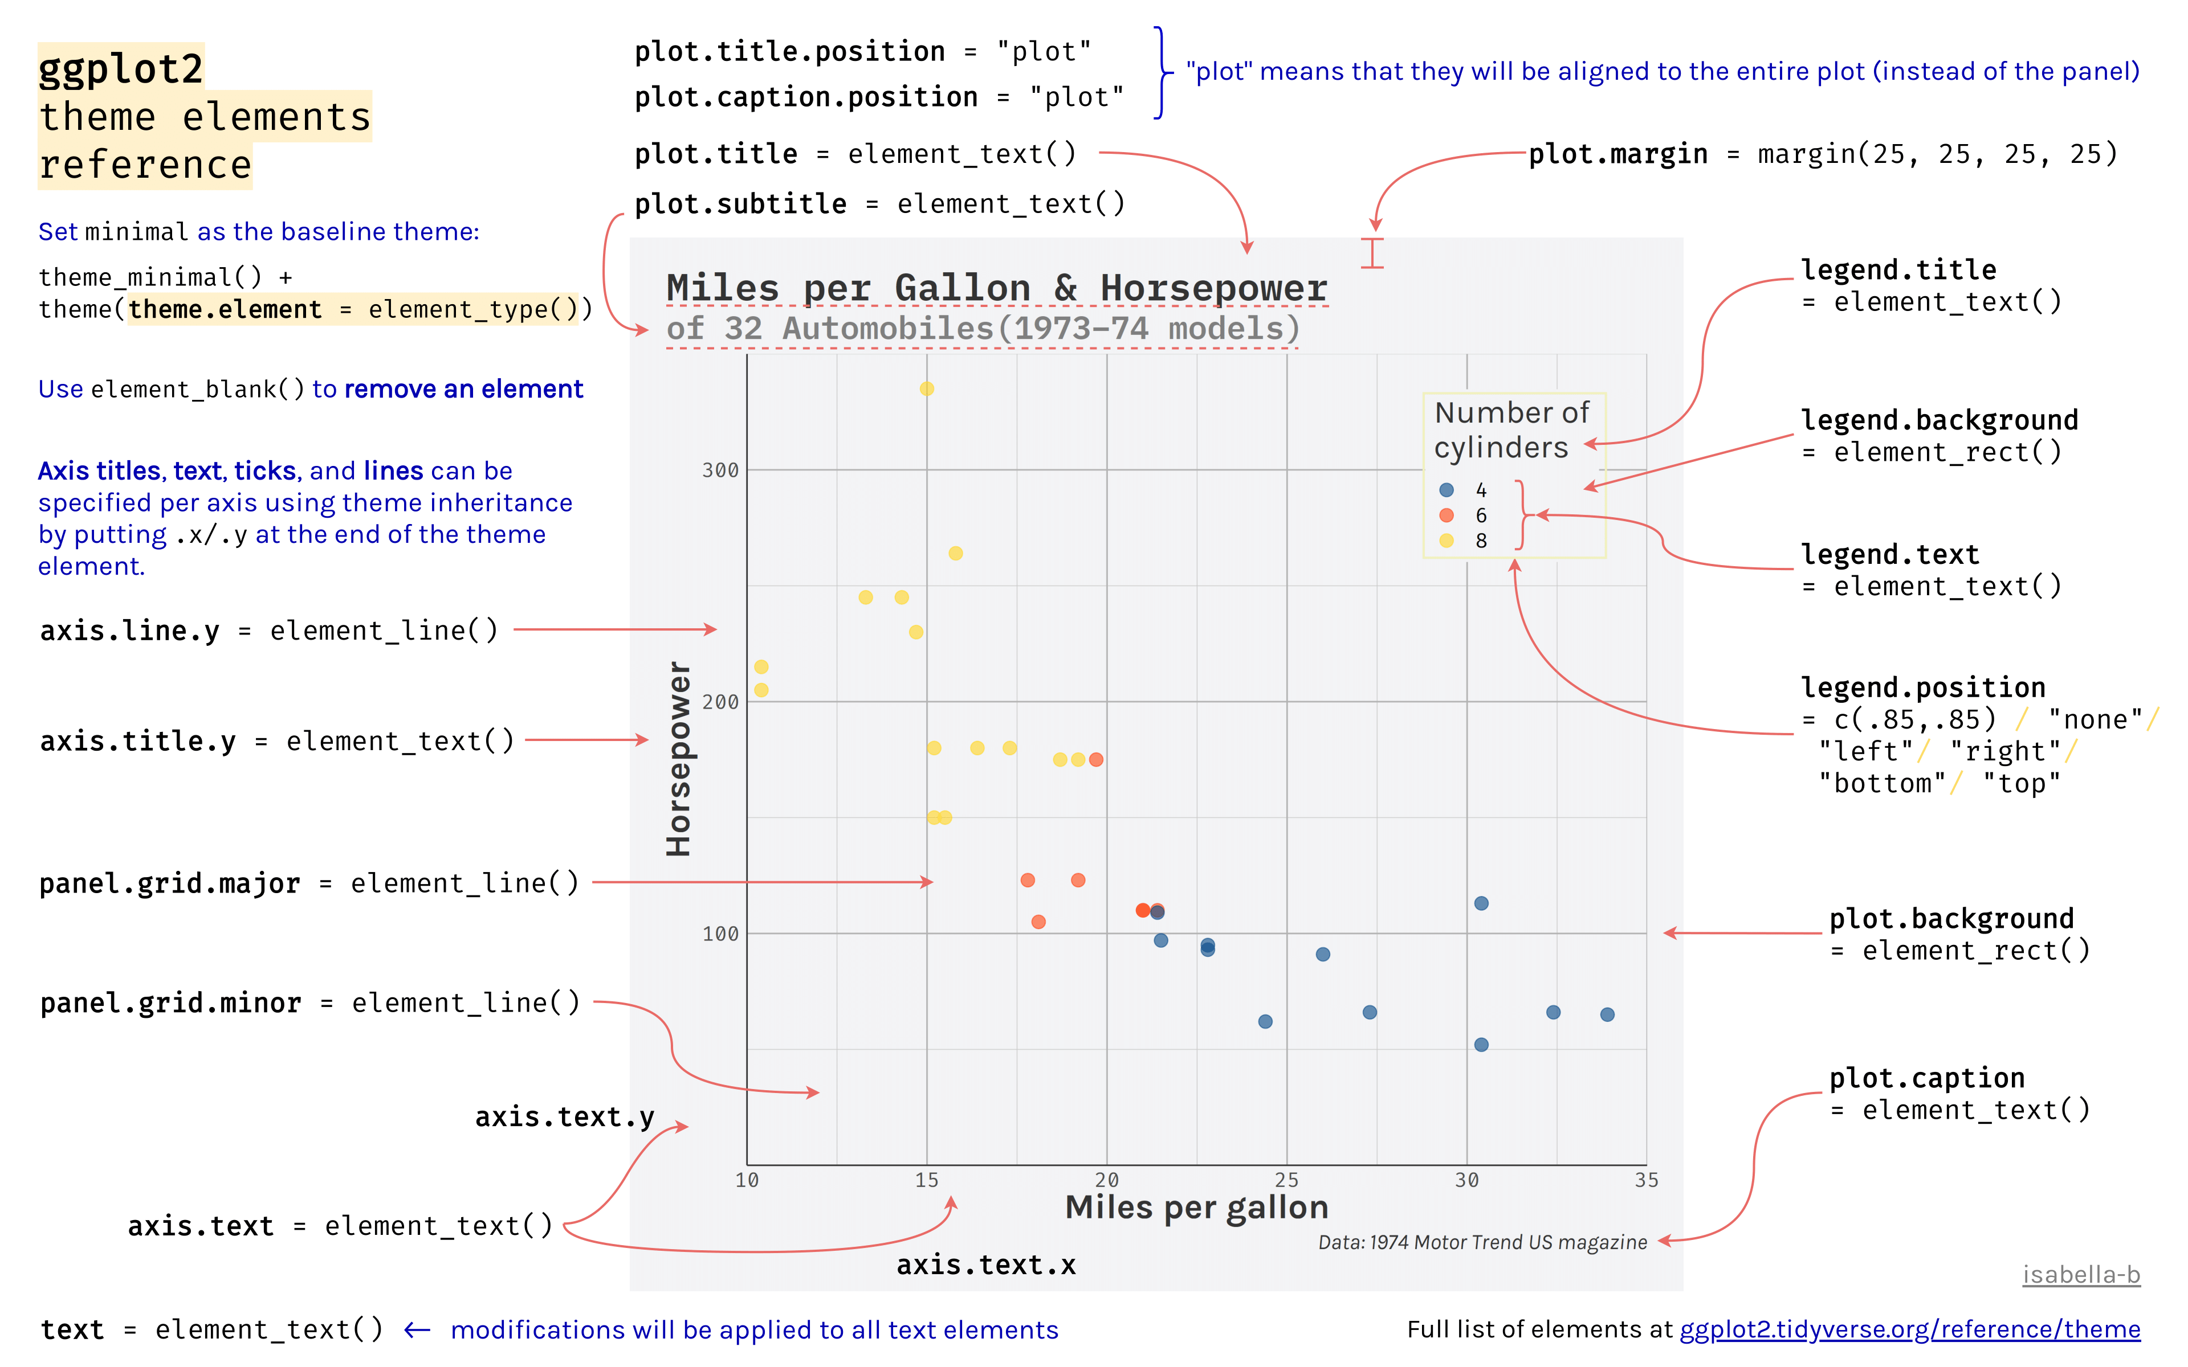

Slide 35
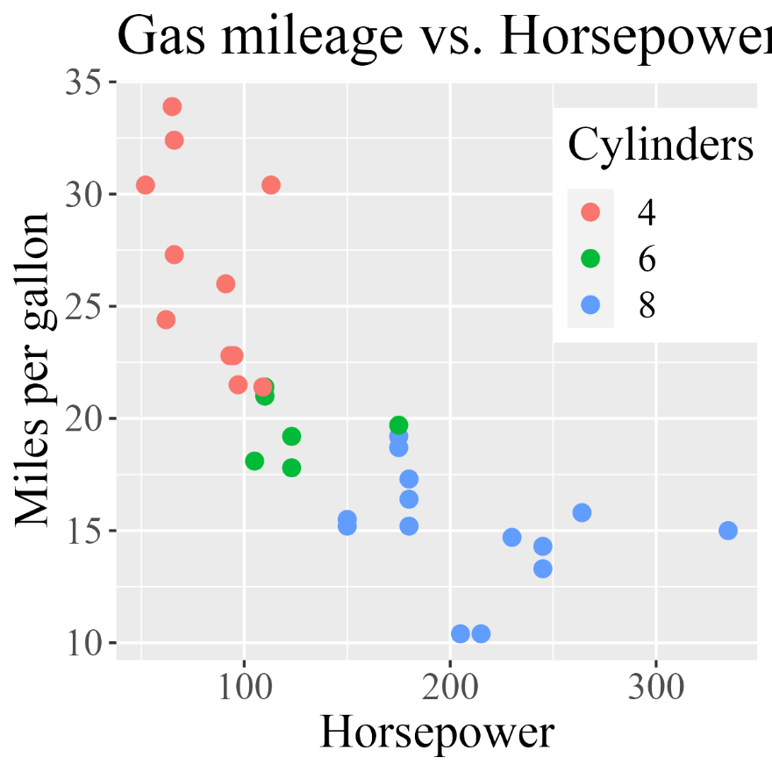
Styling with themes: text
Change the font family
p1 + theme(
legend.position = “inside”,
legend.position = c(0.85, 0.75),
text = element_text(size=18, family = "serif") )
Change the font family & size for all text.
OR
Change specific text items:
axis.title = element_text()
axis.text = element_text()
legend.title =
legend.text =
…
NB: could also use
theme_gray(base_size=, base_family=, …)

Slide 36

Styling with themes: backgrounds
Change the backgrounds
p1 + theme(
legend.position = “inside”,
legend.position = c(0.85, 0.75),
text = element_text(size=18, family = "serif"),
plot.background = element_rect(fill="green"),
panel.background =
element_rect(fill="lightyellow")
)

Slide 37

Custom themes
You can define & save your own theme and then use to style all plots consistently
theme_ugly <- function (base_size = 12, base_family = "") {
theme_gray(base_size = base_size, base_family = base_family)
%+replace%
theme(
axis.text = element_text(colour = "white"),
axis.title.x = element_text(colour = "pink", size=rel(3)),
axis.title.y = element_text(colour = "blue", angle=45),
panel.background = element_rect(fill="green"),
panel.grid.minor.y = element_line(size=3),
panel.grid.major = element_line(colour = "orange"),
plot.background = element_rect(fill="red")
)
}
Start with a base theme
override these properties
Use theme_update() to change just a few elements in the current theme
theme_update(panel.grid.minor = element_line(colour = "red"))

Slide 38

Styling with themes
Use your theme:
p1 + theme_ugly() +
theme(legend.position = c(0.85, 0.75))
To set a theme as the default for all subsequent graphics:
theme_set(theme_bw())
theme_set(theme_ugly())
Recall Wilkinson: GoG can produce hideous graphics … but cannot produce a meaningless one

Slide 39
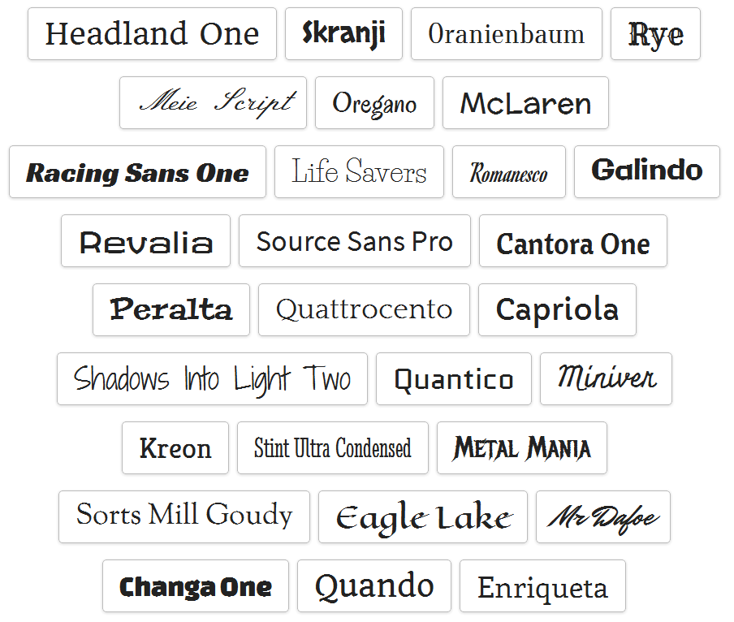
Gimme nicer fonts, please
Base R has access to a limited number of font families
Google fonts has ~1600 font families
R family | Font (Win)
sans | Arial
serif | Times New Roman
mono | Courier
symbol | Σψμβθλ
These can be rendered in plain face, bold, italic, or bold italic
The showtext package is among the easiest for using custom fonts
https://cran.rstudio.com/web/packages/showtext/vignettes/introduction.html

Slide 40


Basic font manipulations
A simple plot
library(ggplot2)
theme_set(theme_gray(base_size = 14))
base_fig <- ggplot(data = economics, aes(date, pop)) +
geom_line(linewidth = 1.3) +
labs(title = "Total US population over time",
subtitle = "Population in thousands",
x = "Date",
y = "Total population (in thousands)")
base_fig
To change all text in the figure to serif, update the text option of the theme
base_fig +
theme(text = element_text(family = "serif"))
You can also change fonts for any component, e.g., plot.title, axis.title, …

Slide 41

showtext package
Setup:
Fonts are actually registered with the sysfonts package
Any local font can be registered with font_add()
library(showtext)
## Load some Google fonts (https://fonts.google.com/)
# args: Google name, R name
font_add_google("Gochi Hand", "gochi")
font_add_google("Schoolbell", "bell")
## Automatically use showtext to render text
showtext_auto()
font_add(“Times New Roman”)
Use in a histogram (base R):
set.seed(123)
hist(rnorm(1000), breaks = 30,
col = "steelblue", border = "white",
main = "", xlab = "", ylab = "")
title("Histogram of Normal Random Numbers",
family = "bell", cex.main = 2)
title(ylab = "Frequency",
family = "gochi", cex.lab = 2)
text(2, 70, "N = 1000", family = "bell", cex = 2.5)

Slide 42

showtext demo
library(showtext); library(glue)
font_add_google('Lora', 'lora’)
font_add_google('Lobster', 'lobster’)
font_add_google('Anton', 'anton’)
font_add_google('Fira Sans', 'firasans’)
font_add_google('Syne Mono', 'syne’)
# Enable showtext font rendering!
showtext_auto()
tib <- tibble(
family = c('firasans', 'lora', 'lobster', 'anton', 'syne'),
x = 0,
y = seq(.9, .1, length.out = 5),
label = glue('Showtext {family}. What a font!'))
tib |>
ggplot(aes(x, y, label = label)) +
geom_text(family = tib$family,
size = 12, hjust = 0, col = 'dodgerblue4') +
coord_cartesian(xlim = c(0, 1), ylim = c(0, 1)) +
theme_void() +
theme(plot.background = element_rect(fill = grey(.90)))
Add a bunch of fonts
Example from: https://albert-rapp.de/posts/ggplot2-tips/08_fonts_and_icons/08_fonts_and_icons.html

Slide 43

Re-visioning old masters in ggplot2
In the Commercial and Political Atlas, William Playfair used charts of imports and exports from England to its trading partners to ask “How are we doing”?

Slide 44
Playfair: Balance of trade charts
In the Commercial and Political Atlas, William Playfair used charts of imports and exports from England to its trading partners to ask “How are we doing”?
Here is a re-creation of one example, using ggplot2. How was it done?
> data(EastIndiesTrade,package="GDAdata")
> head(EastIndiesTrade)
Year Exports Imports
1 1700 180 460
2 1701 170 480
3 1702 160 490
4 1703 150 500
5 1704 145 510
6 1705 140 525
… … …
Code for this example: https://friendly.github.io/6135/R/playfair-east-indies.R

Slide 45



ggplot thinking
I want to plot two time series, & fill the area between them
Start with a line plot of Exports vs. Year: geom_line()
Add a layer for the line plot of Imports vs. Year
c1 <-
ggplot(EastIndiesTrade, aes(x=Year, y=Exports)) +
ylim(0,2000) +
geom_line(colour="black", linewidth=2) +
geom_line(aes(x=Year, y=Imports), colour="red", linewidth=2)
Fill the area between the curves: geom_ribbon()
change the Y label
c1 <- c1 +
geom_ribbon(aes(ymin=Exports, ymax=Imports), fill="pink") +
ylab("Exports and Imports")

Slide 46
That looks pretty good. Add some text labels using annotate()
c1 <- c1 +
annotate("text", x = 1710, y = 0, label = "Exports", size=4) +
annotate("text", x = 1770, y = 1620, label = "Imports", color="red", size=4) +
annotate("text", x = 1732, y = 1950, label = "Balance of Trade to the East Indies", color="black", size=5)
Finally, change the theme to b/w
c1 <- c1 + theme_bw()

Slide 47

Plot what you want to show
Playfair’s goal was to show the balance of trade with different countries.
Why not plot Exports – Imports directly?
c2 <-
ggplot(EastIndiesTrade, aes(x = Year, y = Exports - Imports)) +
geom_line(colour="red", linewidth=2) +
ylab("Balance = Exports - Imports") +
geom_ribbon(aes(ymin=Exports-Imports, ymax=0), fill="pink",alpha=0.5) +
annotate("text", x = 1710, y = -30, label = "Our Deficit", color="black", size=5) +
theme_bw()
aes(x=, y=) can use expressions calculated from data variables

Slide 48

Composing several plots
ggplot objects use grid graphics for rendering
The gridExtra package has functions for combining or manipulating grid-based graphs
library(gridExtra)
grid.arrange(c1, c2, nrow=1)

Slide 49


General composing: patchwork
The patchwork package provides a new, complete syntax for plot compositions
library(patchwork)
p1 <- ggplot(mtcars) + geom_point(aes(mpg, disp))
p2 <- ggplot(mtcars) + geom_boxplot(aes(gear, disp, group = gear))
p1 + p2
Details at: https://patchwork.data-imaginist.com/

Slide 50




General composing: patchwork
The patchwork package provides a new, complete syntax for plot compositions
p1 + p2 side-by-side
p1 + (p2 / p3)
grouping
p1 / p2 up/down
p1 + p2 +p3 + p4 + plot_layout(nrow=3)
fancy layouts
Details at: https://patchwork.data-imaginist.com/

Slide 51
Arbuthnot’s data on birth ratios
Custom graphs can be constructed by adding graphical elements (points, lines, text, arrows, etc.) to a basic ggplot()
John Arbuthnot: data on male/female sex ratios:
figure caption (inside)
> data(Arbuthnot, package=“HistData”)
> head(Arbuthnot[,c(1:3,6,7)])
Year Males Females Ratio Total
1 1629 5218 4683 1.114 9.901
2 1630 4858 4457 1.090 9.315
3 1631 4422 4102 1.078 8.524
4 1632 4994 4590 1.088 9.584
5 1633 5158 4839 1.066 9.997
6 1634 5035 4820 1.045 9.855
… … … … … …
Arbuthnot didn’t make a graph. He simply calculated the probability that in 81 years from 1629—1710, the sex ratio would always be > 1
The first significance test!
regression line & loess smooth
reference line

Slide 52

Building a custom graph
ggplot(Arbuthnot, aes(x=Year, y=Ratio)) +
ylim(1, 1.20) +
ylab("Sex Ratio (M/F)") +
geom_point(pch=16, size=2)
Start with a basic scatterplot, Ratio vs. Year
R script for this example: https://friendly.github.io/6135/R/arbuthnot-gg.R

Slide 53

Building a custom graph
ggplot(Arbuthnot, aes(x=Year, y=Ratio)) +
ylim(1, 1.20) +
ylab("Sex Ratio (M/F)") +
geom_point(pch=16, size=2) +
geom_line(color="gray")
Connect points with a line

Slide 54

Building a custom graph
ggplot(Arbuthnot, aes(x=Year, y=Ratio)) +
ylim(1, 1.20) +
ylab("Sex Ratio (M/F)") +
geom_point(pch=16, size=2) +
geom_line(color="gray") +
geom_smooth(method="loess", color="blue",
fill="blue", alpha=0.2) +
geom_smooth(method="lm", color="darkgreen",
se=FALSE)
# save what we have so far
arbuth <- last_plot()
Add smooths:
loess curve
linear regression line

Slide 55

Building a custom graph
arbuth +
geom_hline(yintercept=1, color="red", linewidth=2) +
annotate("text", x=1645, y=1.01, label="Males = Females", color="red", size=5)
Add horizontal reference line
& text label

Slide 56

Building a custom graph
arbuth +
geom_hline(yintercept=1, color="red", linewidth=2) +
annotate("text", x=1645, y=1.01, label="Males = Females", color="red", size=5) +
annotate("text", x=1680, y=1.19,
label="Arbuthnot's data on the\nMale / Female Sex Ratio", size=5.5)
Add figure title (but inside!)

Slide 57
Building a custom graph
arbuth +
geom_hline(yintercept=1, color="red", linewidth=2) +
annotate("text", x=1645, y=1.01, label="Males = Females", color="red", size=5) +
annotate("text", x=1680, y=1.19,
label="Arbuthnot's data on the\nMale / Female Sex Ratio", size=5.5) +
theme_bw() + theme(text = element_text(size = 16))
Change the theme and font size

Slide 58




Guerry: Moral statistics of France
Guerry (1833) made shaded maps of France to determine if crime was related to literacy & other factors
library(Guerry)
library(sp)
spplot(gfrance, "Crime_pers")
spplot(gfrance, "Crime_prop")
spplot(gfrance, "Literacy")

Slide 59


Consulting for Guerry
Guerry: Mes cartes sont très jolies, non? But how can I go further?
MF: Make scatterplots! Add smooths & data ellipses. See you next week at Café Lillas
Guerry: Les boissons sont pour moi, mon ami!

Slide 60

Building Guerry’s plots
ggplot(aes(x=Literacy, y=Crime_pers/1000), data=Guerry) +
geom_point(size=2)
Start with a basic scatterplot
(Crime_pers = # of persons per crime against persons. I divide by 1000 to keep the axis labels short)

Slide 61

Building Guerry’s plots
ggplot(aes(x=Literacy, y=Crime_pers/1000), data=Guerry) +
geom_point(size=2) +
stat_ellipse(level=0.68, color="blue", linewidth=1.2) +
stat_ellipse(level=0.95, color="gray", linewidth=1, linetype=2)
Add data ellipses to show correlation
68% ~ mean ± 1 sd
95% ~ mean ± 2 sd

Slide 62

Guerry’s plots: Add smooths
ggplot(aes(x=Literacy, y=Crime_pers/1000), data=Guerry) +
geom_point(size=2) +
stat_ellipse(level=0.68, color="blue", linewidth=1.2) +
stat_ellipse(level=0.95, color="gray", linewidth=1, linetype=2) +
geom_smooth(method="lm", formula=y~x, fill="lightblue") +
geom_smooth(method="loess", formula=y~x, color="red", se=FALSE)
Add lm() and loess() smooths
lm shows regression slope
loess diagnoses possible non-linearity
Coffee break: save the current plot object
gplot <- last.plot()

Slide 63

Guerry’s plots: Styling
Guerry: I want to publish this! But ditch that grey background & make text larger
gplot <- last_plot()
gplot + theme_bw() +
theme(text = element_text(size=18))
Could also use:
gplot + theme_bw(base_size=18)
MF:
I’ll change the basic theme to theme_bw()
Increase the font size for all text
You can change the style of anything you want
I’ll create a theme_Guerry() you can use in all your graphs
Guerry:
Looking better, mon ami

Slide 64

Guerry’s plots: Labeling
Guerry: OK, but I see some unusual points. What are they?
MF: Need to calculate “unusualness” – Mahalanobis D² squared distance from centroid
gdf <- Guerry[, c("Literacy", "Crime_pers", "Department")]
gdf$dsq <- gdf$dsq <- heplots::Mahalanobis(gdf[, 1:2])
$D^{2}$= $(x−\overline{x})′$S⁻¹ $(x−\overline{x})′$
library(ggrepel)
gplot +
theme_bw() +
theme(text = element_text(size=18)) +
geom_label_repel(aes(label=Department),
data = gdf[gdf$dsq > 4.6,])
(D² ~ χ² w/ 2 df, so Pr(D² > 4.6) = 0.10)

Slide 65


Penguin tour-de-force
Thompson, Cara. 2022. “Level Up Your Labels: Tips and Tricks for Annotating Plots.” https://www.cararthompson.com/talks/user2022.

Slide 66

Penguins: How this was made
camcorder pkg makes a GIF animation of steps in constructing a graph
Thompson, Cara. 2022. “Level Up Your Labels: Tips and Tricks for Annotating Plots.” https://www.cararthompson.com/talks/user2022.

Slide 67

Beyond 2D: Contour plots
Data on eruptions of geysers at Old Faithful (Yellowstone Natl Park)
> str(faithful)
'data.frame': 272 obs. of 2 variables:
$ eruptions: num 3.6 1.8 3.33 2.28 4.53 ...
$ waiting : num 79 54 74 62 85 55 88 85 51 85 ...
p <- ggplot(faithful, aes(waiting, eruptions))
p + geom_density_2d(linewidth=1.2) +
labs(x = "Waiting time",
y = "Eruption time")
geom_density_2d() calculates relative frequency (density) over a grid of X, Y values
It plots contours of equal density

Slide 68

Contours: add another layer
We also want to see the data: add points
p + geom_density_2d() +
geom_point() +
labs(x = "Waiting time",
y = "Eruption time") +
theme_bw(base_size = 16)
Note use of base_size to control all size elements
Layers add “ink” so consider their order: I added points last

Slide 69


Other forms: Filled contours, hex bins
p +
geom_density_2d_filled(show.legend
= FALSE)
p +
geom_hex(bins=30, color="gray") +
scale_fill_viridis_c(direction = -1) +

Slide 70


Real 3D: rayshader
The rayshader package produces stunning 3D visualizations of X, Y, Z data
Z (“elevation”) data above an X, Y plane
Allows:
photo-realistic lighting & shading
animation
camera motion
cinematic depth of field
computationally intensive

Slide 71


rayshader::plot_gg()
A volcano:
plot_gg(): Plots a ggplot2 object in 3D by mapping the color or fill aesthetic to elevation.
ggvolcano <-
volcano %>%
ggplot() + geom_contour(…)
plot_gg(ggvolcano, …)
From: https://www.rayshader.com/reference/plot_gg.html

Slide 72

Give your data the full 3D treatment (if you dare)
ggdiamonds <-
ggplot(diamonds, aes(x, depth)) +
stat_2d_density(…) +
facet_wrap(clarity ~ .)
“Please Ma, can I have it in 3D?”

Slide 73

Give your data the full 3D treatment (if you dare)
ggdiamonds <-
ggplot(diamonds, aes(x, depth)) +
stat_2d_density(…) +
facet_wrap(clarity ~ .)
plot_gg(ggdiamonds, zoom = 0.55,
phi = 30, …)

Slide 74




Animation
An animation is a sequence of frames showing a series of related images
•••
•••
frames
time
Frames can be based on:
data subsets (year)
plot attributes (color, shape)
plot elements or layers
…
Enter / exit types:
fade
grow / shrink
fly / drift
Transition effects:

Slide 75

Animation with gganimate
Draw density curves for life expectancy over years
-- separate curve for each year
data(gapminder, package=“gapminder”)
p <- gapminder %>%
ggplot(aes(lifeExp, fill = factor(year))) +
geom_density(alpha=.2) +
xlab("Life Expectancy") +
ylab("Kernal density") +
guides(fill = guide_legend(title = "Year"))
plot(p)
This is pretty, but there is too much going on
→ Animate to show changes over years

Slide 76

Make it an animation
Frames are defined by transition_*()
functions
enter_*, exit_*, ease_* functions define the change between transition states
p +
transition_time(year) +
ease_aes('linear’)
anim_save(“gap-anim.gif”,
nframes=20)

Slide 77

Frames: transition_*()

Slide 78

transition_time()
The classic Rosling moving bubble plot
plt <-
ggplot(gapminder,
aes(x = gdpPercap, y = lifeExp,
size = pop, colour = country)) +
geom_point(alpha = 0.7) +
scale_colour(values=country_colors) +
scale_size(range = c(2, 15)) +
scale_x_log10(labels = scales::comma) +
theme_bw() +
theme(legend.position = "none",
plot.title = element_text(size = 25),
axis.title = element_text(size = 20 ))
plt +
labs(title = 'Year: {frame_time}’) +
transition_time(year) +
ease_aes('linear')

Slide 79

transition_layers()
transition_layers(): Add layers or geoms one at a time
ggplot(mtcars, aes(y=mpg, x=wt)) +
geom_point(size=3, alpha=0.5) +
labs(x="Car Weight (1000 lbs)",
y="Miles Per Gallon") +
ggtitle("1974 Motor Trend Cars: Gas Mileage
vs. Weight [Frame {frame} ]") +
theme_minimal(base_size = 14) +
geom_smooth(method = "lm", color="red") +
geom_smooth(method = "loess", color="blue") +
# do the animation, by layers
transition_layers() +
enter_fade() +
enter_grow()
element grows as it enters

Slide 80
Summary
Understand ggplot components
aes(): map data variables to visual features
geoms, stats, scales, …
think in terms of layers:
+ geom_point(), + geom_line(), + geom_smooth()
themes
basic themes, extension packages
theme components, custom themes
Fonts: use showtext
Going beyond 2D: contour/density plots
Animation

